Slide 1

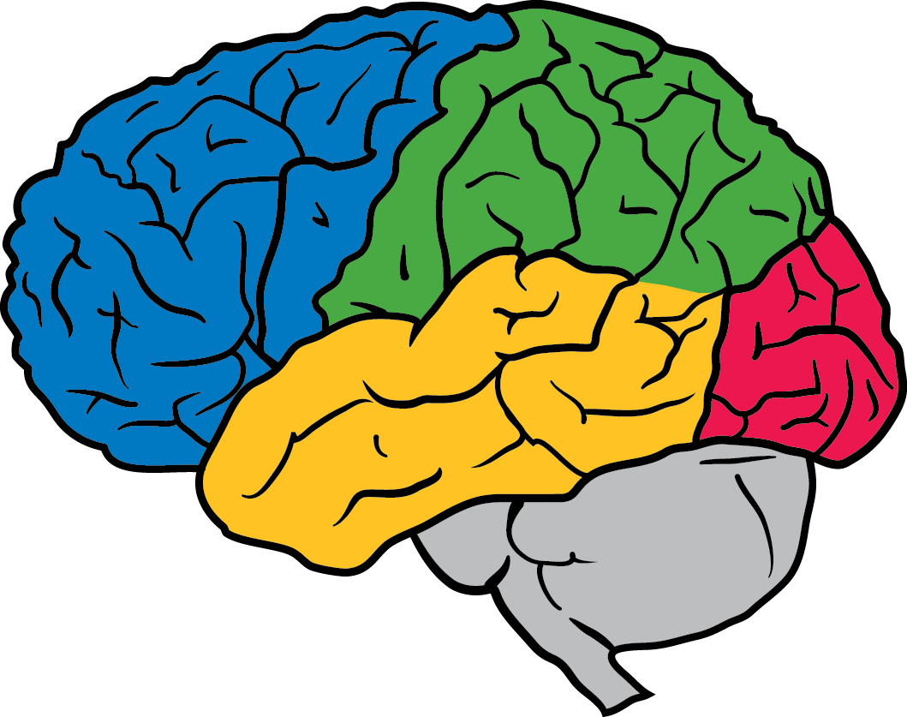
Estimating Example Difficulty using Variance of Gradients
Chirag Agarwal*, Sara Hooker*
Notes:
Welcome to our talk. Today we will be discussing our recent paper entitled “Estimating Example Difficulty using Variance of Gradients” This is an initial work which we presented at ICML workshop and are currently building out by expanding to larger datasets. I would appreciate everyone's valuable feedback and suggestions.

Slide 2
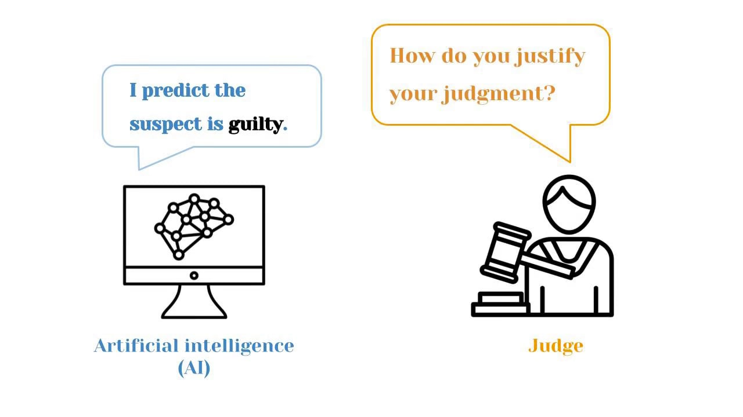
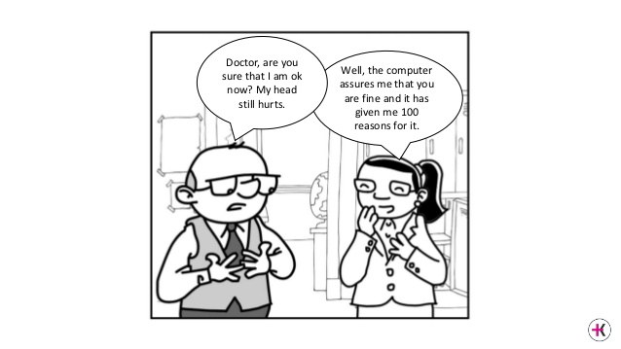
Interpretability in current models?
Justice system
Medical diagnosis
Notes:
The current surge in Explainable AI research is a result of the increasing use of Machine learning, in particular deep learning, models to real-life applications like self-driving cars, criminal justice, job-application systems, battlefield simulations, and health-care.
We need to look beyond test accuracies and ask for additional interpretability measures from current DNN models.
To this end, scholars are working towards models motivated with the need of techniques that enable humans to interact with them.

Slide 3
Motivation for Studying Relative Importance
Automatically surfaces high priority examples for human inspection
Intra and Inter class understanding
Model bias
Notes:
> Understanding individual sample importance is very useful given that modern datasets are large with sometimes consisting of more than 1M images. not feasible for an individual to look at individual explanations for each data point in a large dataset?
> It is critical to understand the relative importance of individual classes and inspect images that the model finds most challenging.
> The current work in XAI is focused on explaining model behavior on single explanation which do not highlight the inherent bias of the model towards colors and textures

Slide 4
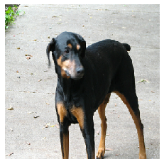
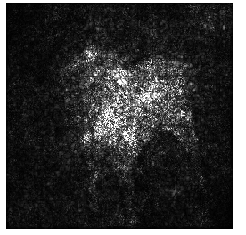

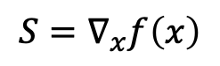
Gradient
Saliency maps can be noisy and ‘uninterpretable’
Notes:
Clear connection to neural network function

Slide 5
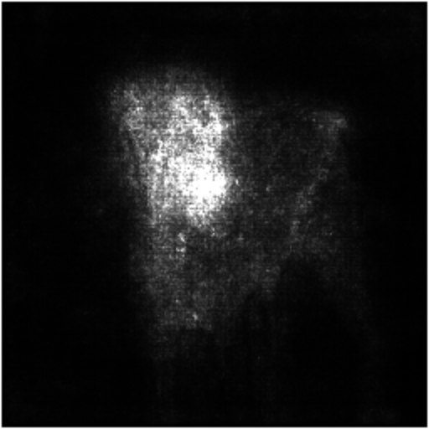
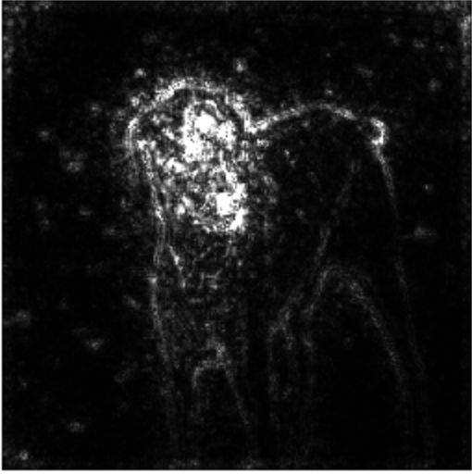
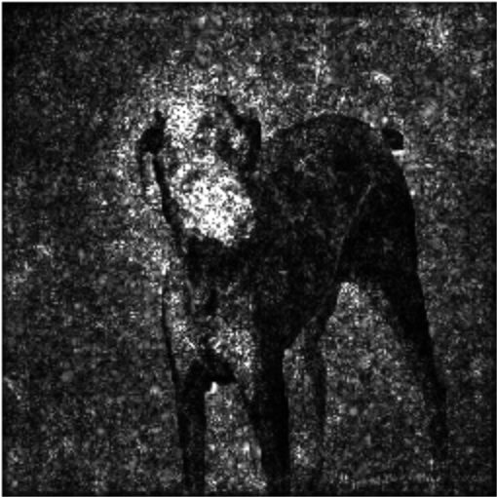
Different variants of Gradients
Gradient
SmoothGrad
GuidedBackProp
IntergratedGrad

Slide 6
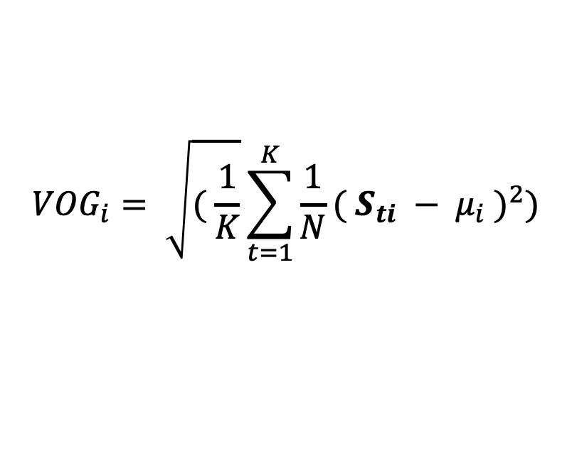
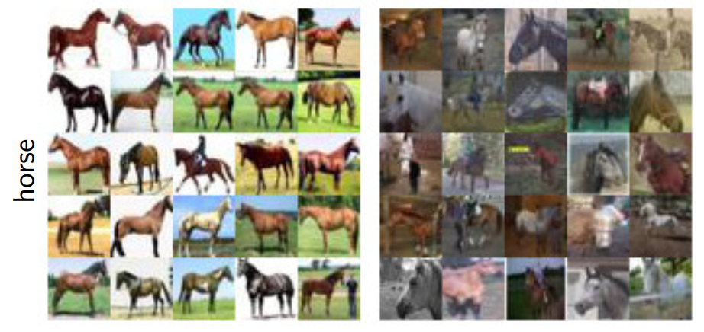
Why Variance Of Gradients?
Lowest VOG
Highest VOG
Notes:
Input gradients serve as an easy way to analyze their respective behavior during the course of the training. Gradients of easy examples converge quickly to a small range as compared to challenging examples.
Following this hypothesis, we use variance of gradients as a proxy metric for quantifying the relative importance between individual samples of the training and testing datasets.
For any given sample I, we calculate it’s VOG score using its gradients at Nt checkpoints. On analyzing the images using VOG score, we found that images having low and high VOg scores are very different from each other. Here we see horses on clean background have lower scores as compared to the ones having higher VOG score.

Slide 7
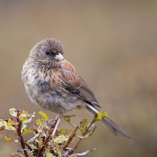
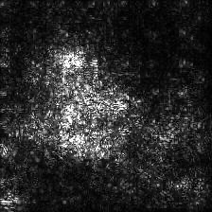
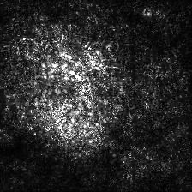
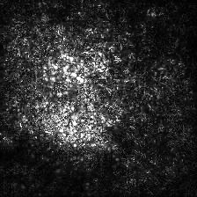
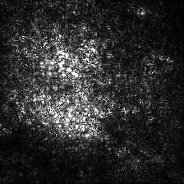
Variance Of Gradients
Compute the average variance in gradients (VOG) for an image over training
0 epochs
90 epochs
Notes:
Input gradients serve as an easy way to analyze their respective behavior during the course of the training. Gradients of easy examples converge quickly to a small range as compared to challenging examples.
Following this hypothesis, we use variance of gradients as a proxy metric for quantifying the relative importance between individual samples of the training and testing datasets.
For any given sample I, we calculate it’s VOG score using its gradients at Nt checkpoints. On analyzing the images using VOG score, we found that images having low and high VOg scores are very different from each other. Here we see horses on clean background have lower scores as compared to the ones having higher VOG score.

Slide 8
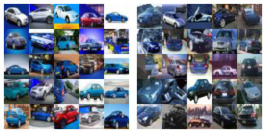
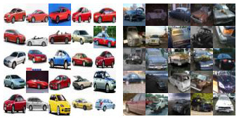
Understand how feature importance forms over the course of training.
Low Variance
High Variance
Low Variance
High Variance
0 epochs
90 epochs
Early-stage training
Late Stage Training
Achille et al. 2017. Critical learning periods in deep neural networks. arXiv preprint arXiv:1711.08856. Mangalam, K. and Prabhu, V. U. Do deep neural networks learn shallow learnable examples first. 2019.
Jiang et al. 2020.. Exploring the memorization-generalization continuum in deep learning. arXiv preprint arXiv:2002.03206
Notes:
Many works have shown that there exists different stages of training a DNN

Slide 9
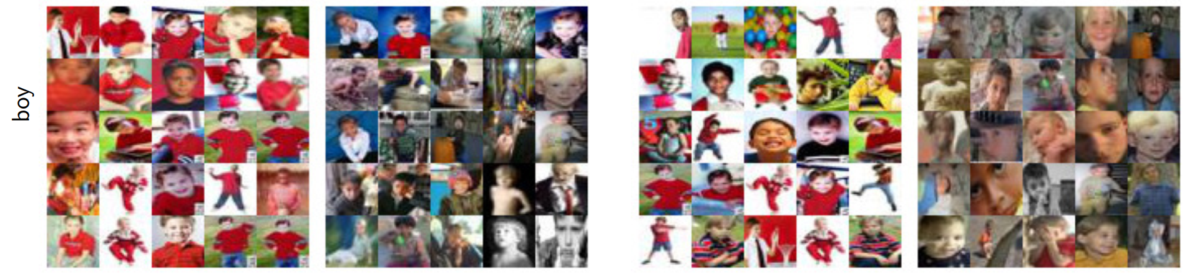
VOG computes a relative ranking of each class
Higher VOG score samples have cluttered backgrounds
Lowest VOG
Highest VOG
Lowest VOG
Highest VOG
Early-stage training
Late-stage training
Notes:
We divided the training process into two stages, early-stage comprising of first three checkpoints and late-stage comprising of last 3 checkpoints. The proposed VOG score discriminates images with clean and cluttered backgrounds. More importantly, it can be used to understand biases in the individual classes as for this class, boys wearing red shirts were easily learnt by the model

Slide 10
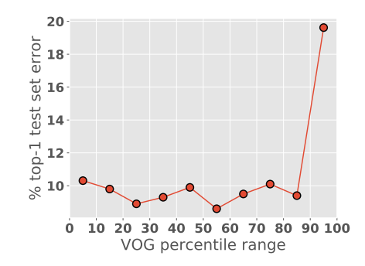
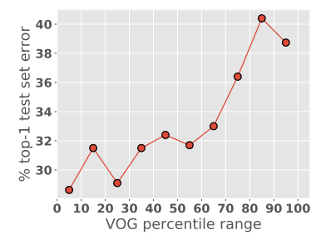
VOG effectively discriminates easy & challenging examples
Mis-classification increases with an increase in VOG scores
CIFAR-10
CIFAR-100
Notes:
For quantitative analysis, the line plot shows the relationship between the VOG score and the testing error.
We observe that examples at the lowest percentiles of VOG have far lower error rates. The misclassification increases with an increase in VOG scores

Slide 11
Memorization experiment
Overparameterized networks achieve zero training error by memorizing examples*
Replace 20% of all labels in the training set with random shuffled labels
Re-train the model from random initialization and compute VOG scores
*Zhang et al. Understanding deep learning requires rethinking generalization. arXiv preprint arXiv:1611.03530, 2016.

Slide 12
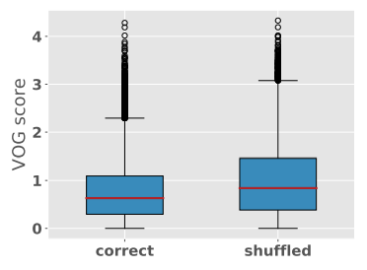
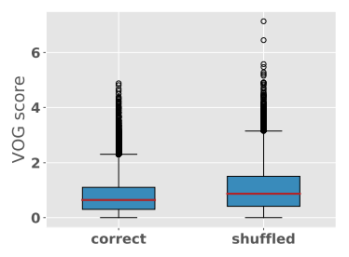
VOG distribution
Higher mean (red line) and spread for shuffled data
CIFAR-10
CIFAR-100

Slide 13
Future directions
Use VOG score to analyze complex datasets
Investigate various dataset and model bias
Leverage VOG to aid in curriculum learning

Slide 14
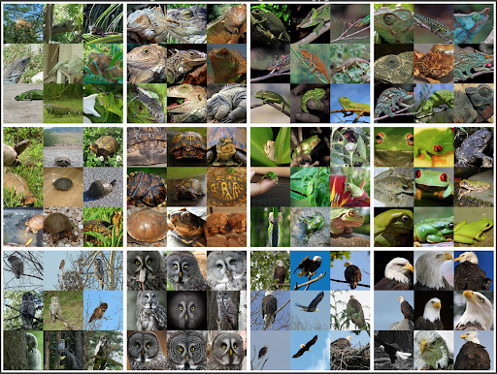
Preliminary
ImageNet
results

Slide 15

Final takeaways
An interpretability tool for ranking training and test examples
No need for modifying the architecture
VOG aids in clustering images with distinct visual properties
Paper: https://arxiv.org/pdf/2008.11600.pdf chiragagarwall12@gmail.com
@_cagarwal
shooker@google.com
@sarahookr

